Slide 1
The effects of ALAN on fish behavior
Maxximus Ramsaroop

Slide 2
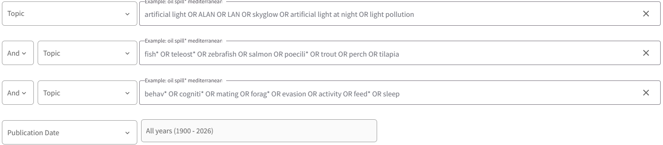
What are the effects of ALAN on fish behavior?
Scoping Search
Biological cycles organize by photoperiods
Light dependent processes are evolutionarily ancient
Light pollution is growing increasingly around coastal and freshwater environments
Sensory pollutants uniquely alter animal behavior through skewing sensory perception
* to be revised

Slide 3
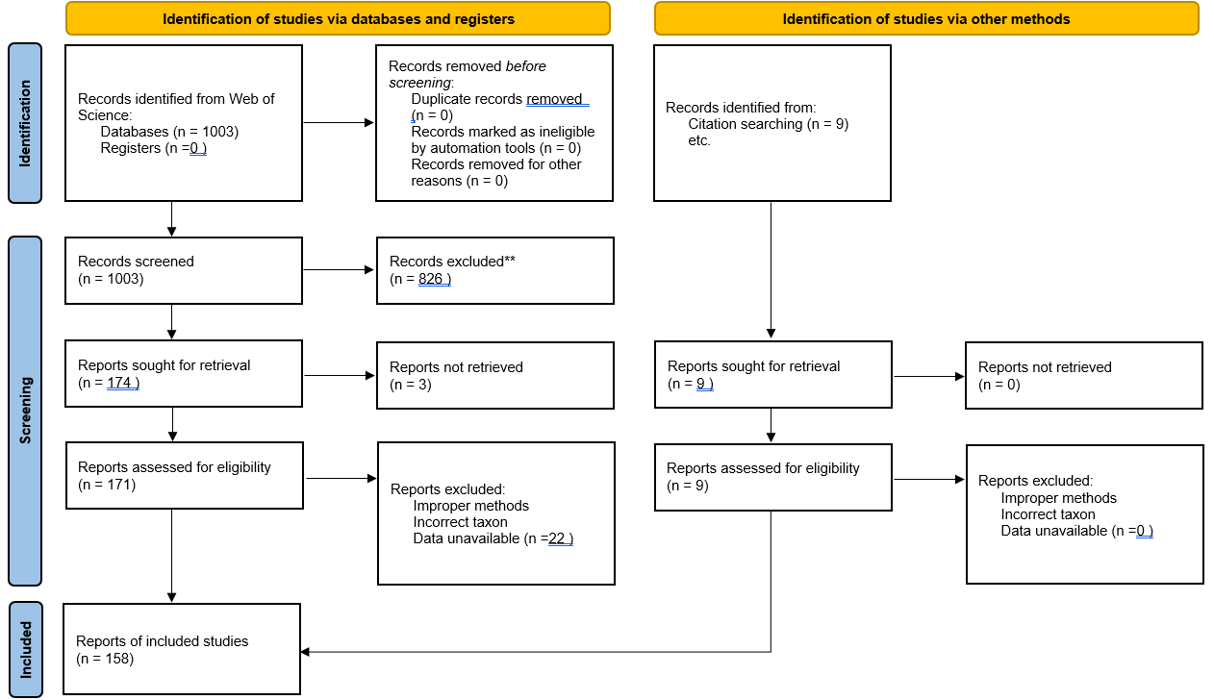
Quote
PRISMA Flowchart

Slide 4
Moderators
ALAN moderators:
Intensity
Wavelength
Duration
Biological moderators:
Behavioral type
Species & Sex
Life stage & ecology
Study moderators:
Lab/Field study
Behavioral assay
Year & Country of Origin

Slide 5
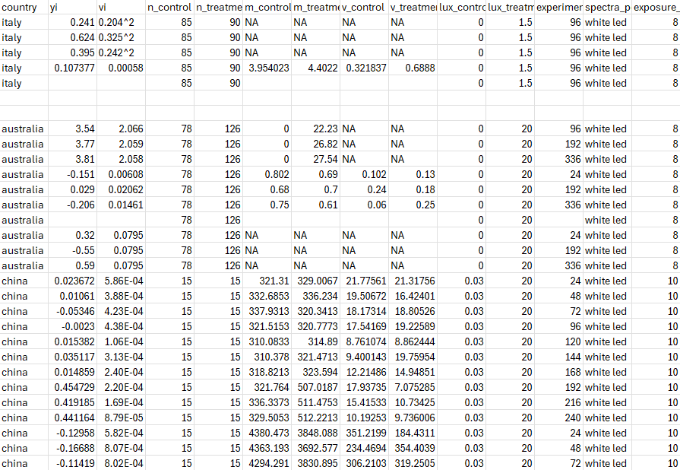
A glance at my dataset
Extracted 221 effect sizes from 4 studies
Includes 22 moderators
Used random effects MA on log(RR) data

Slide 6
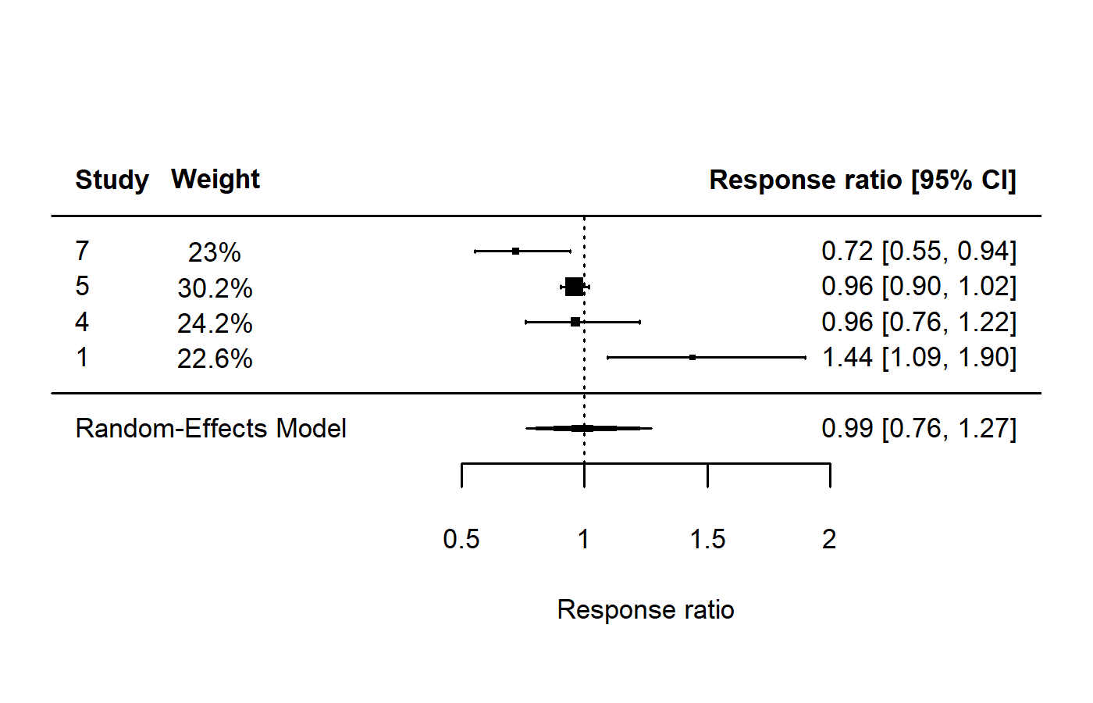
What are the overall effects of ALAN on Behavior?
No grand mean effect
Behavioral endpoints leave this largely difficult to interpret
7 Kurvers et al. 2018
rma.mv( yi, vi,
random = ~ 1 | Study_ID/effect_ID,
data = df_ma, method = "REML")
5 Li et al. 2024
4 Georgiou et al. 2024
1 Lucon-xiccato et al. 2023

Slide 7
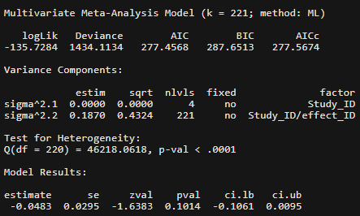
What are the overall effects of ALAN on Behavior?
No grand mean effect
Behavioral endpoints leave this largely difficult to interpret
LOTS of heterogeneity & within study var.
7 Kurvers et al. 2018
rma.mv( yi, vi,
random = ~ 1 | Study_ID/effect_ID,
data = df_ma, method = "REML")
5 Li et al. 2024
4 Georgiou et al. 2024
1 Lucon-xiccato et al. 2023

Slide 8
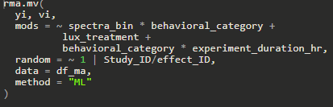
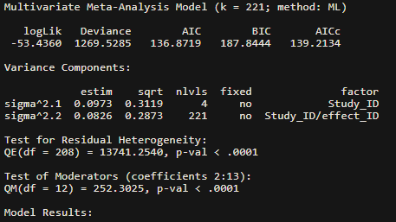
How do moderators explain heterogeneity in our results?
Moderators reduce QE heterogeneity & increase AIC
Significantly improved fit (LRT)
Only fit some major moderators
Within study variance decreases but between study variance increases

Slide 9
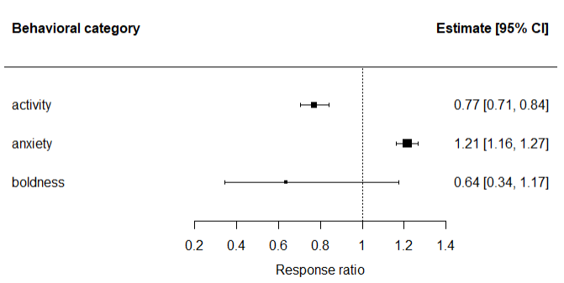
Fish exhibit various behavioral responses to ALAN
Fish are less active and more anxious under ALAN
Activity measured as the mean velocity over several minutes
Anxiety measured as “thigmotaxis” or wall hugging behavior
Boldness is often the time to emerge from a shelter
Behavioral traits do not perfectly translate across contexts

Slide 10
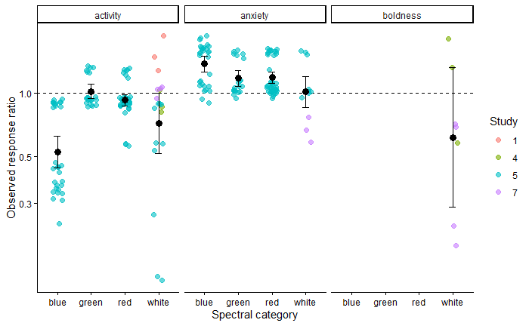
Different colors have different behavioral effects
Mostly driven by study 5
White light most applicable across studies but contains multiple spectral peaks
Activity result probably most reliable here

Slide 11
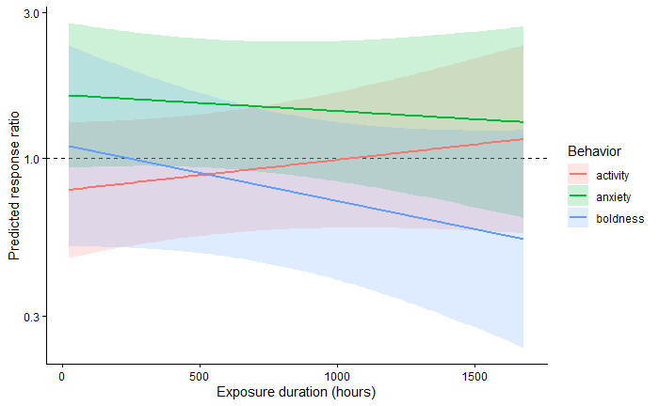
Future Directions & Meta-regression
Very preliminary meta-regression
Include more moderators
Calculate ln(CVR) variation
Perform actual meta-regressions
Improve search criterion
Run sensitivity analyses
Test publication bias

